Slide 1
Numeron

Slide 2
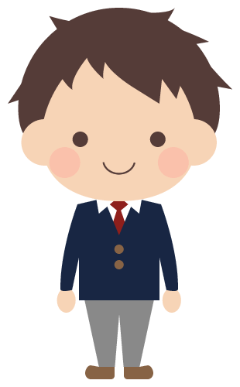
Rules
Goal : To guess a number decided by the other person
0 to 9 ⇒ three-digit number ※Do not use the same number more than once
〇105 ×115
Eat
105
Is it 801?
Bite
1EAT-1BITE

Slide 3
Example
382
Call 165 ⇒ ０EAT-０BITE 1, 6, 5 are not included in the set numbers.
Call 325 ⇒ １EAT-１BITE 3 and 2 are included.
Call 389 ⇒ 2EAT- 0BITE 3 is the hundreds place. 8 or 9 is correct.
Call 382 ⇒ 3EAT-０BITE

Slide 4
Practice ①
746
Is it 648?
1EAT-1BITE

Slide 5
Practice ②
Is it 205?
0EAT-3BITE
Which is the most likely one?
a) 204 b) 520 c) 502
Which is the most likely one?
a) 204 b) 520 c) 502

Slide 6
Practice ③
1EAT-2BITE
How many possible numbers are there?
a) 3 b) 4 c) 5
How many possible numbers are there?
a) 3 b) 4 c) 5

Slide 7
Rules
Once for each question
① Sum of the three digits 105 ⇒ 1＋0＋5＝6
② Product of the three digits 105 ⇒ 1×0×5＝0
③ Even or odd 105 ⇒ Odd 106 ⇒ Even
If you use a question, you can’t guess the number that turn.

