Slide 1
How to See Rainbows

Slide 2
Questions
Red Color : Outside or Inside?
Radius (in degrees)
Width? (in degrees)
Length?
Where? When?
Brighter : Outside or Inside?
2nd bow?

Slide 3
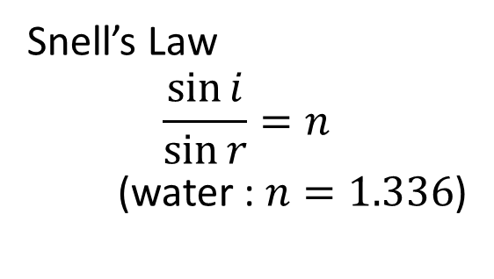
Sun
Raindrop
i
A
r
180゜-(4r-i)
B
r
i
r
4r
φ
δ
4r-i
r
C
i
i
Snell’s Law
$$\frac{\sin{i}}{\sin{r}}=n$$
(water : $n=1.336$)
δ＝180゜-(4r-i)+i=180゜-4r+2i
φ＝180゜-δ＝4r-2i

Slide 4
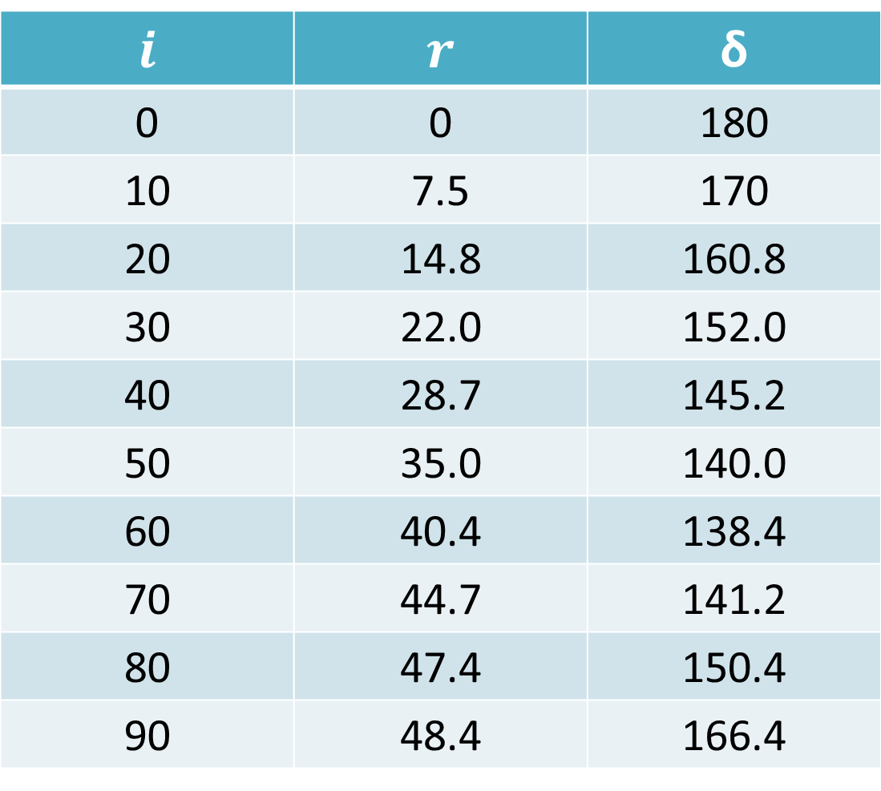
m
$$i$$ | $$r$$ | δ
0 | 0 | 180
10 | 7.5 | 170
20 | 14.8 | 160.8
30 | 22.0 | 152.0
40 | 28.7 | 145.2
50 | 35.0 | 140.0
60 | 40.4 | 138.4
70 | 44.7 | 141.2
80 | 47.4 | 150.4
90 | 48.4 | 166.4

Slide 5
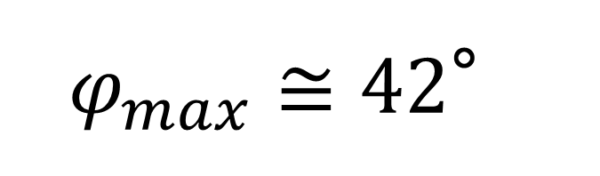
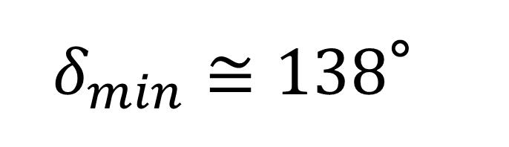
$δ_{min}≅138$°
$φ_{max}≅42$°
No light
42°
42°

Slide 6




$$n_{red}=1.331$$
$φ_{max}≅$42.4°
$$n_{violet}=1.343$$
$φ_{max}≅$ 40.6°
No light
White

Slide 7
No light
42°
White
42°
Raindrop

Slide 8
40.6°
42.4°
Raindrop

Slide 9
42°
42°
Raindrop

Slide 10


42°

Slide 11
Sun
Raindrop
i
A
r
r
B
r
φ
δ
r
C
i

Slide 12


Sun
$θ_{max}≅$50.4°
Raindrop
$θ_{max}≅$ 53.5°
A
D
B
θ
C

Slide 13
50.4°
53.5°
Raindrop

Slide 14
Q.1 Red Color : Outside or Inside?
Q.2 Radius Q.3 Width
Q.6 Brighter : Outside or Inside?
No light
Red : Outside
Radius : 42.4°
Width : 1.8°
40.6°
42.4°
White

Slide 15


Q4. Length of the Bow
Longer
Shorter

Slide 16




Q.5 Where? and When?
Late morning ～ Early afternoon
East
West
East
West
Morning
Afternoon

Slide 17
Q.7 Secondary Rainbows
Red : Inside
Radius : 53.5°
Width : 3.1°
Primary Rainbows
Red : Outside
Radius : 42.4°
Width : 1.8°
53.5°
42.4°

Slide 18
