Slide 1
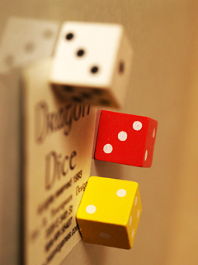
Math World!!
-Dice Challenge-

Slide 2

Introduce your favorite food from your country
Taste
Appearance
How to cook it

Slide 4
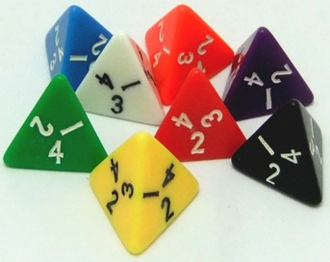
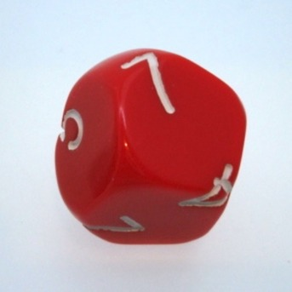
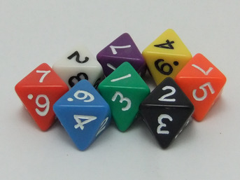
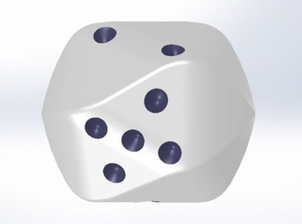
Dice of the World

Slide 5
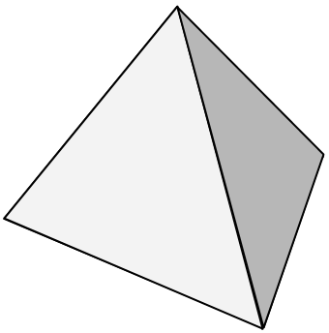
Tetrahedron Dice
A | 1 | 2 | 3 | 4
B | 1 | 1 | 4 | 4
C | 2 | 2 | 3 | 3
D | 2 | 2 | 2 | 4
E | 1 | 3 | 3 | 3
Sum | Expected Value
10 | 2.5
10 | 2.5
10 | 2.5
10 | 2.5
10 | 2.5
Use only numbers 1 to 4
The sum should be 10
Expected values are same
Expected value（期待値＝得られる数値の平均値）

Slide 6
How to Fold a Tetrahedron with A4 Paper
① Fold
Make sure your
folds are sharp
② Fold once more and unfold

Slide 7
③ Fold corner A to the center line. Crease at B
B
A
④ Fold BC to line CD
B
A
C
D

Slide 8
⑤ Fold BE to line EF
E
F
C
D
B
⑥ Fold EC to line BD
E
C
F
B
D

Slide 9
⑦ Fold CF to line BC
C
F
B
E
⑧ Unfold to Step ③

Slide 10
⑨ Insert the red area into the pocket
Pocket
Finished!!

Slide 11
Game Rules
Choose one die.
Throw your the dice at the same time.
The bigger number is the stronger.
The winner is the one who is stronger 3 out of 5 attempts.

Slide 12
Is it a fair game?
Are there any strong dice?
Let’s choose the strongest dice!!!

Slide 13
 | Ａ | Ｂ | Ｃ | Ｄ | Ｅ
Ａ |  | ① | ④ | ③ | ②
Ｂ | ① |  | ② | ⑤ | ③
Ｃ | ④ | ② |  | ① | ⑤
Ｄ | ③ | ⑤ | ① |  | ④
Ｅ | ② | ③ | ⑤ | ④

Slide 14
 |  |  |  |  | Sum | E | Number of win
A | 1 | 2 | 3 | 4 | 10 | 2.5 | 24
B | 1 | 1 | 4 | 4 | 10 | 2.5 | 28
C | 2 | 2 | 3 | 3 | 10 | 2.5 | 24
D | 2 | 2 | 2 | 4 | 10 | 2.5 | 25
E | 1 | 3 | 3 | 3 | 10 | 2.5 | 27
AvsB | 1 | 2 | 3 | 4 |  | AvsC | 1 | 2 | 3 | 4 |  | AvsD | 1 | 2 | 3 | 4 |  | AvsE | 1 | 2 | 3 | 4
1 | - | A | A | A |  | 2 | C | - | A | A |  | 2 | D | - | A | A |  | 1 | - | A | A | A
1 | - | A | A | A |  | 2 | C | - | A | A |  | 2 | D | - | A | A |  | 3 | E | E | - | A
4 | B | B | B | - |  | 3 | C | C | - | A |  | 2 | D | - | A | A |  | 3 | E | E | - | A
4 | B | B | B | - |  | 3 | C | C | - | A |  | 4 | D | D | D | - |  | 3 | E | E | - | A
BvsC | 1 | 1 | 4 | 4 |  | BvsD | 1 | 1 | 4 | 4 |  | BvsE | 1 | 1 | 4 | 4
2 | C | C | B | B |  | 2 | D | D | B | B |  | 1 | - | - | B | B
2 | C | C | B | B |  | 2 | D | D | B | B |  | 3 | E | E | B | B
3 | C | C | B | B |  | 2 | D | D | B | B |  | 3 | E | E | B | B
3 | C | C | B | B |  | 4 | D | D | - | - |  | 3 | E | E | B | B
CvsD | 2 | 2 | 3 | 3 |  | CvsE | 2 | 2 | 3 | 3
2 | - | - | C | C |  | 1 | C | C | C | C
2 | - | - | C | C |  | 3 | E | E | - | -
2 | - | - | C | C |  | 3 | E | E | - | -
4 | D | D | D | D |  | 3 | E | E | - | -
DvsE | 2 | 2 | 2 | 4
1 | D | D | D | D
3 | E | E | E | D
3 | E | E | E | D
3 | E | E | E | D

